Slide 1
Evidence-based Cohesion Policy: Territorial Dimensions
The regional and urban dimension of Europe 2020
Source : Philippe Monfort, Directorate General for Regional Policy, European Commission
29 November 2011, Kraków
ESPON 2013 Programme Internal Seminar

Slide 2
Introduction
June 2010 – European Council approves the Europe 2020 strategy for smart, sustainable and inclusive growth.
Cohesion Policy is mentioned as a key delivery mechanism for Europe 2020.
Regional and local authorities can indeed make a key contribution to this strategy through the actions that fall within their responsibility.
Involving regional authorities in European policies can indeed increase the efficiency of these policies, making the best of territories potential.

Slide 3
Introduction
Debate and reflection are now launched on how to translate the objectives and targets of Europe 2020…
… into their counterpart at regional level.
Regions cannot or should not reach all their national or the EU targets:
  For some regions, distance to the target is simply be too great.
  For some issues, it is not realistic or desirable that all regions reach the same target.
  There are many ways in which a region can contribute to a given objective.

Slide 4
Introduction
Accordingly Cohesion Policy programmes should:
  Select their investment priorities taking into account the starting position of a region or city in relation to the national 2020 targets;
  Identify the manner it can best respond to regional/local development needs...
  … while at the same time contributing to 2020 targets.
7 PR focuses on the first point:
  Assesses how regions and cities can contribute to three types of growth of the Europe 2020 strategy; and
  Measures the distance of cities and regions to the national 2020 targets proposed in NRPs.

Slide 5
Europe 2020 pillars
Smart Growth
  Education
  Innovation
  Digital Society
Sustainable Growth
  Competitiveness
  Resource efficiency
  Climate change
  Biodiversity
Inclusive growth
  Employment
  Poverty and exclusion

Slide 6
Smart Growth
Improve education, promote
R&D and innovation and move towards a digital society.

Slide 7
Education
Human capital is one of the key determinants of regional growth. It favours:
  innovation and rapid diffusion and absorption of knowledge and techniques;
  Productivity, employment and social inclusion;
  Environmental awareness.
Europe 2020 target: increase the share of people aged 30-34 with a tertiary degree to 40 % by 2020.
Currently, only one in five EU regions is at this level. Member States have set themselves targets ranging from 26 % to 60 %.

Slide 8
Education
Education attainment follows GDP per head:
  High in regions eligible under RCE objective (one in three);
  Around the EU average in transition regions (one in four);
  Lower in convergence regions (one in twenty).
The distance to the national target is significant for many regions, like for instance in Portugal, Slovakia or Germany.

Slide 9
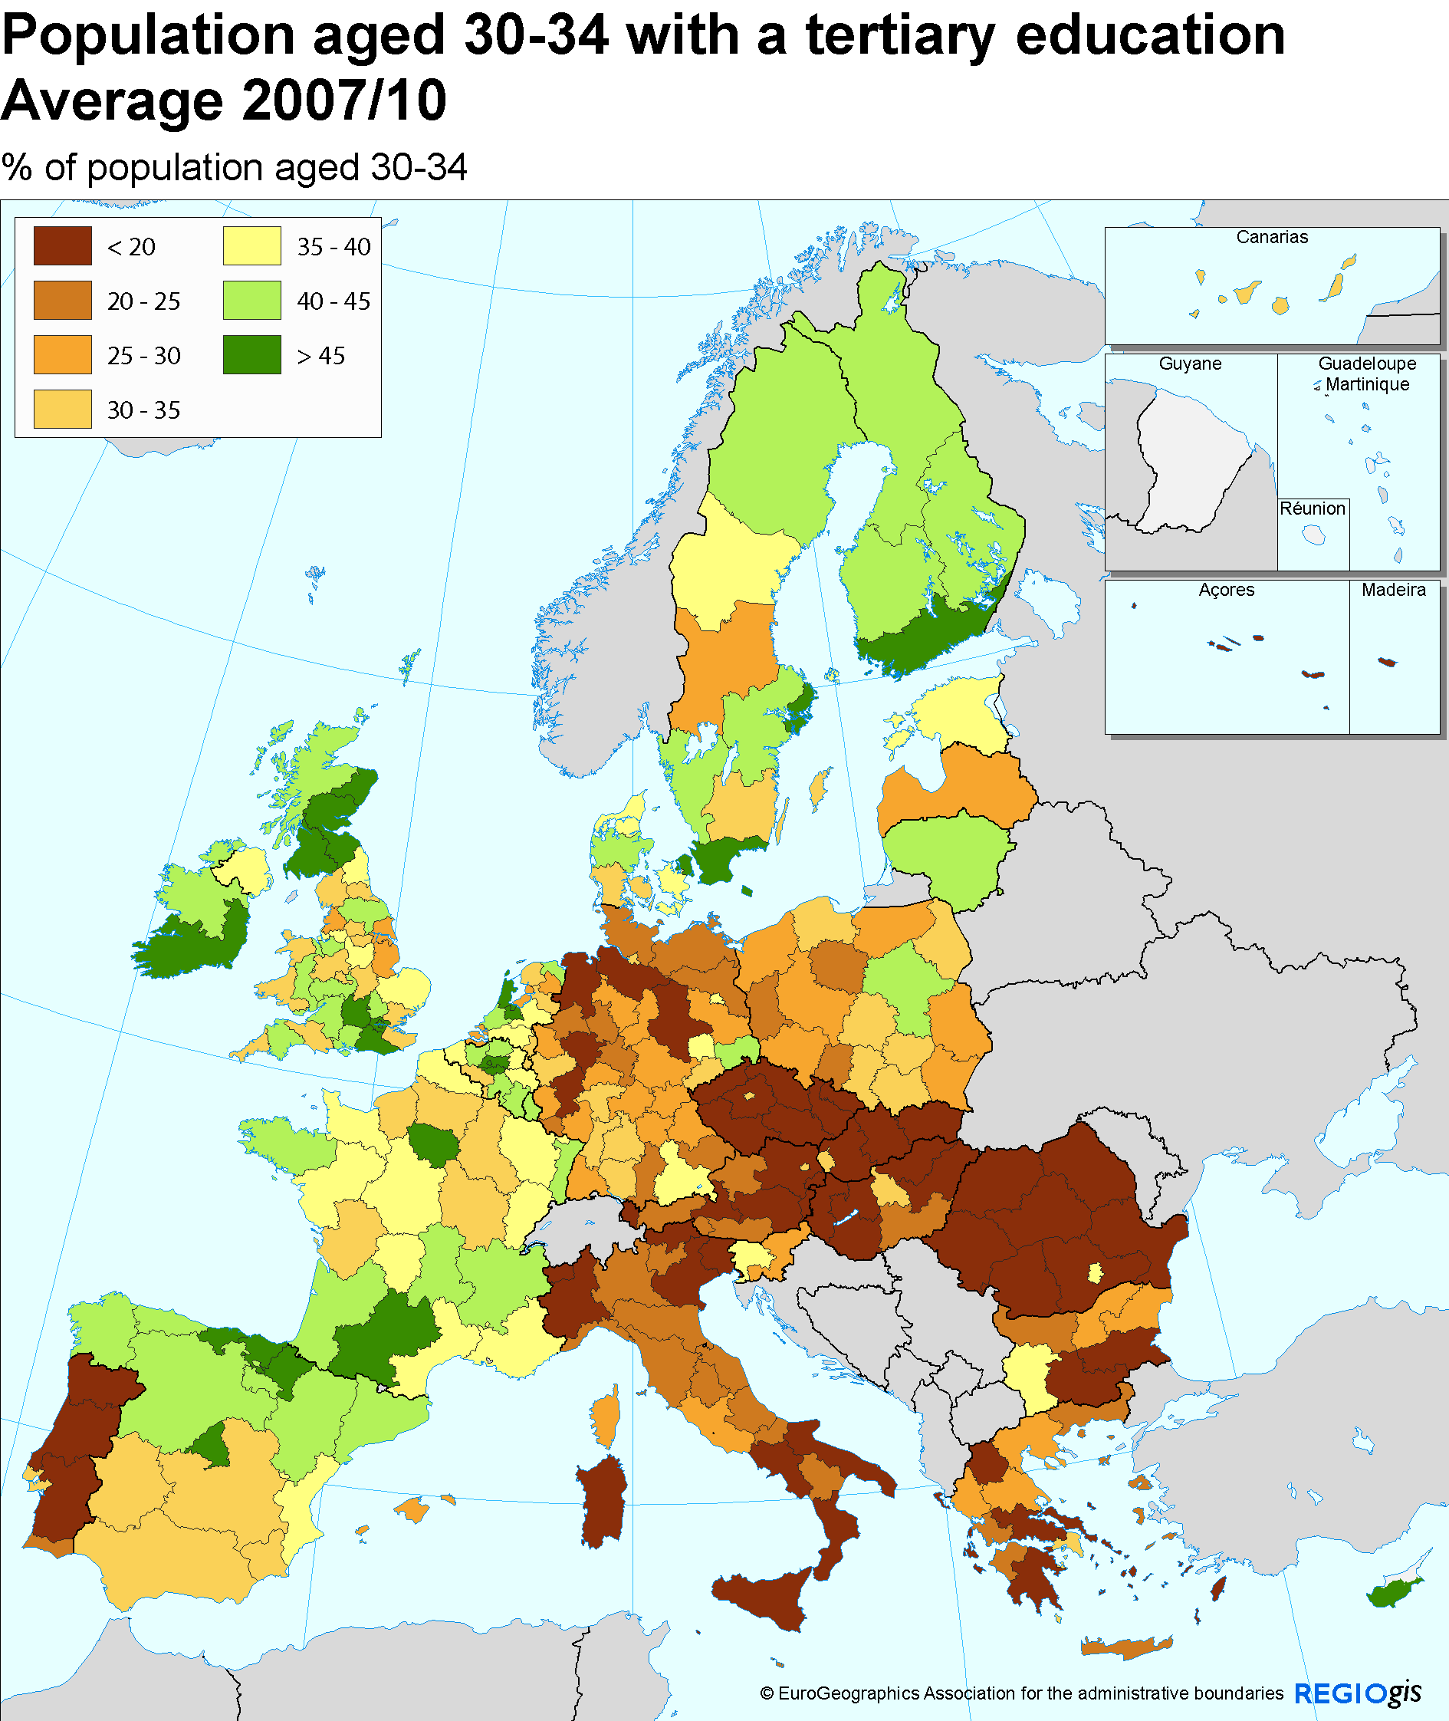
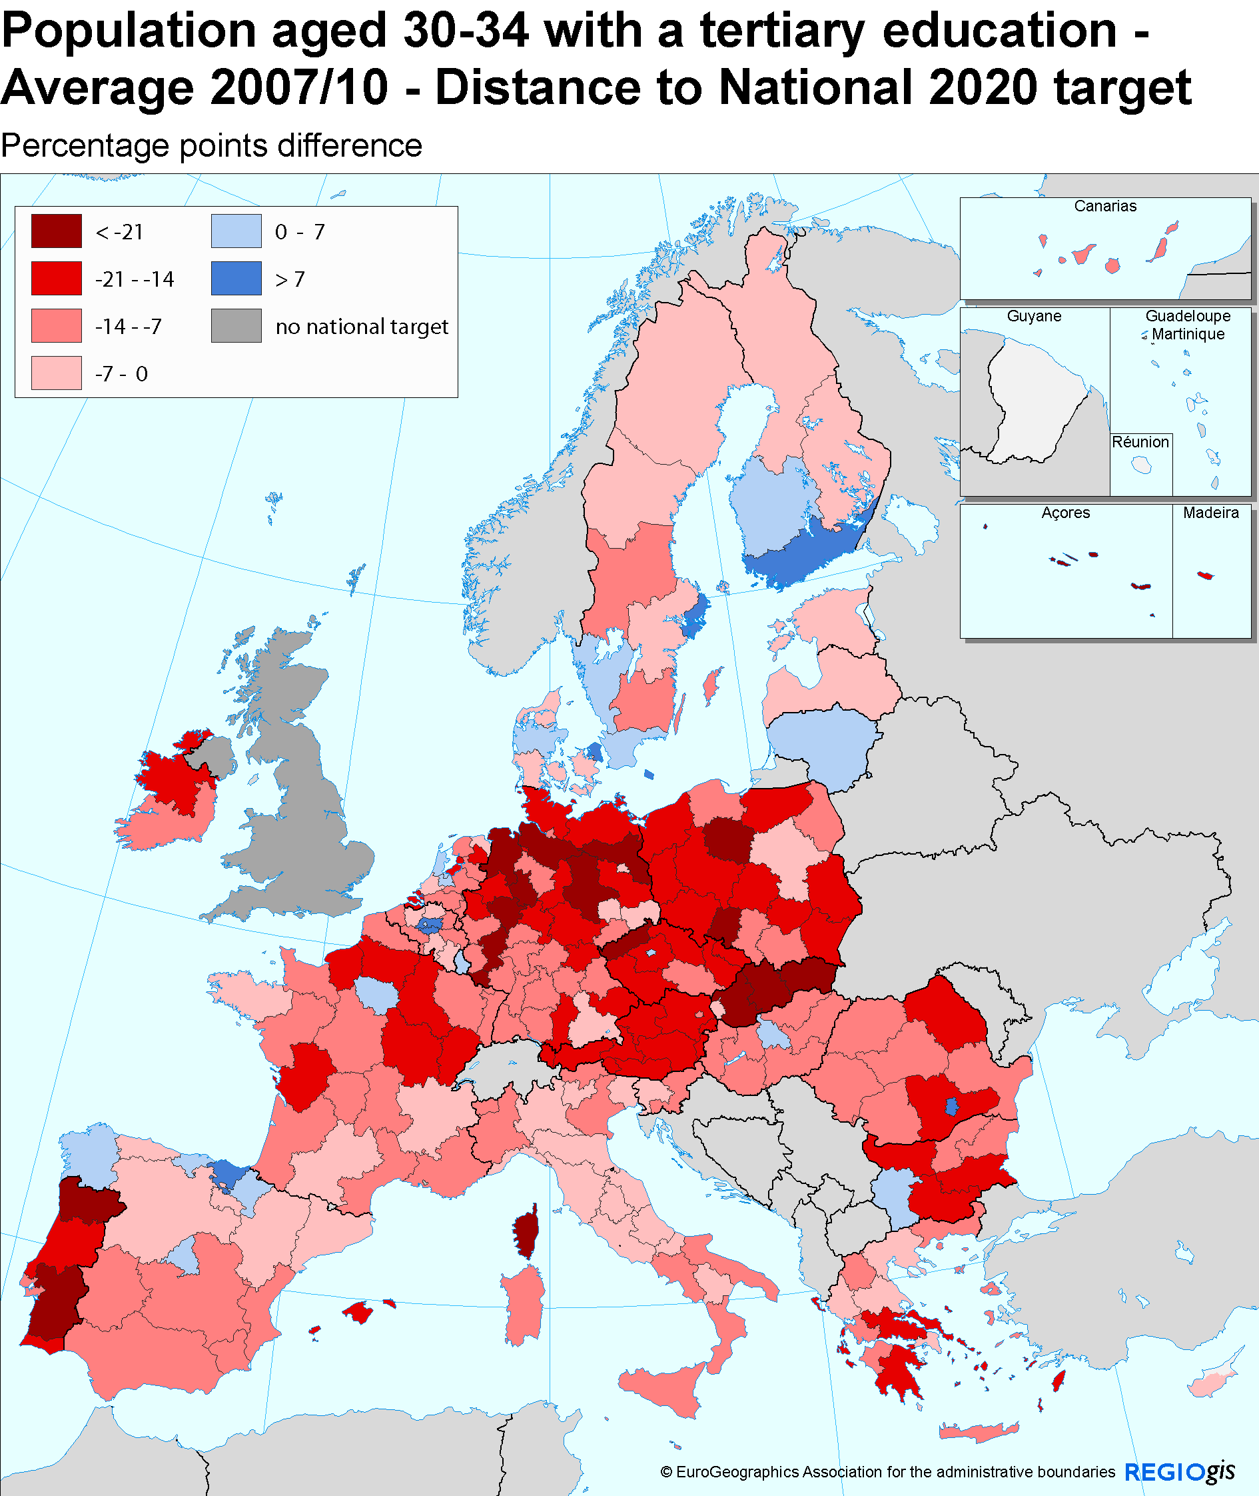
Tertiary education

Slide 10
Education
Education attainment tends to be higher in capitals and adjoining regions.

Slide 11
Cities and tertiary educated

Slide 12
Education
The variation in human capital between regions within a Member State is often larger than between Member States.
Therefore, national strategies need to be complemented by regional policies.

Slide 13
R&D
Technological progress is another important factor of growth and job creation.
Europe 2020 target: 3 % of GDP invested in R&D.
Member States have defined national targets for investments in R&D.
In 2009, R&D expenditure represented 2 % of GDP in the EU-27.

Slide 14
R&D
R&D is typically concentrated in core areas such as capital and metropolitan regions.
Highest R&D expenditure in northern countries (Germany, UK, Sweden and Finland), Austria and capital regions such as Hovedstaden (Copenhagen) and Île de France (Paris).
In 2008, only 16 regions across Europe have reached the national targets set under Europe 2020.
On average R&D expenditure of the convergence regions is only 0.9 % of their GDP.

Slide 15
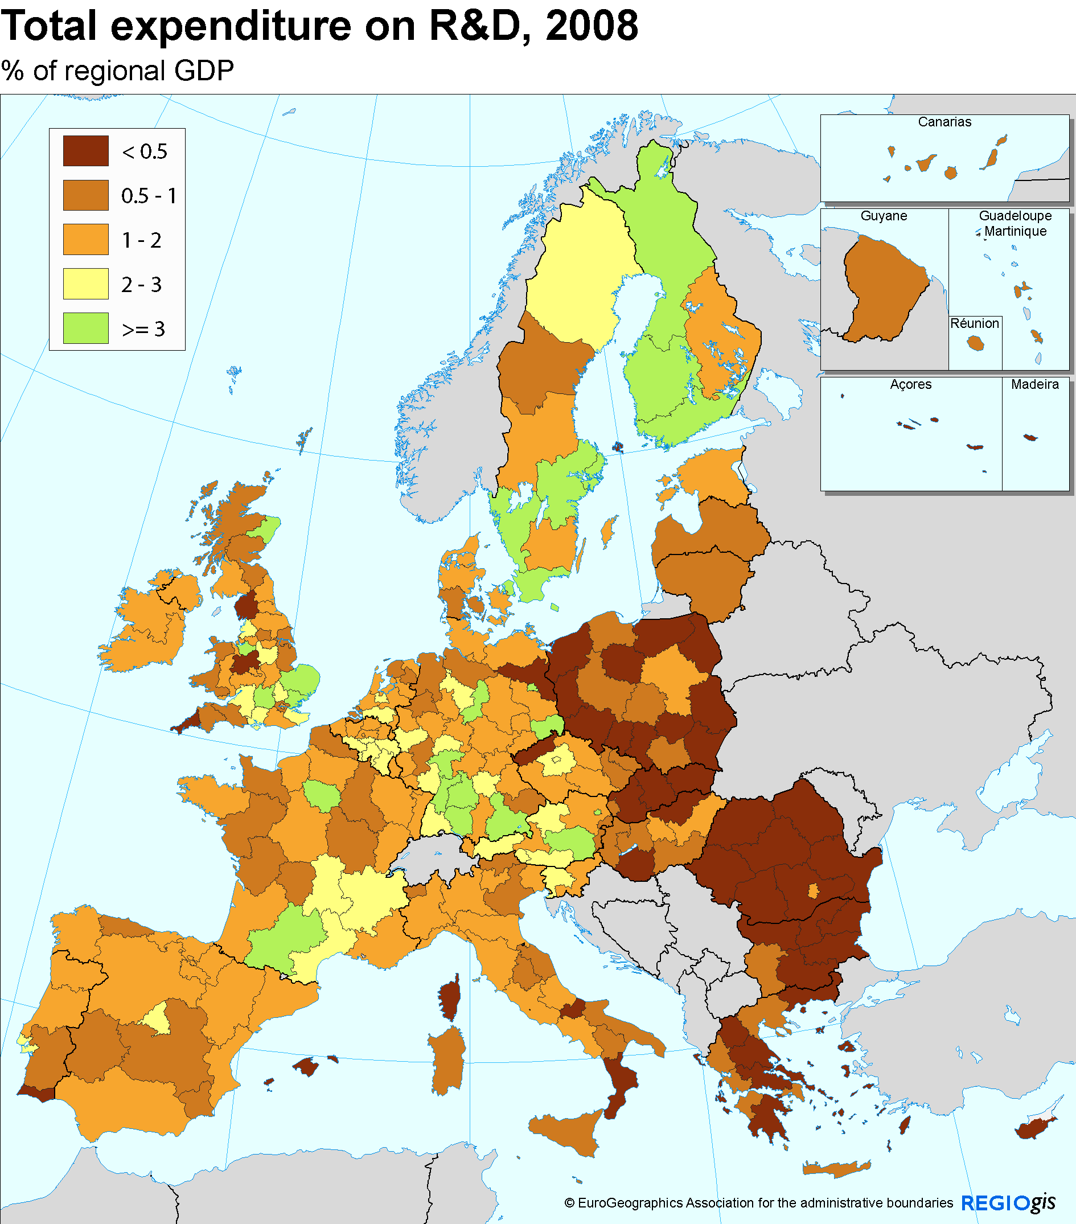
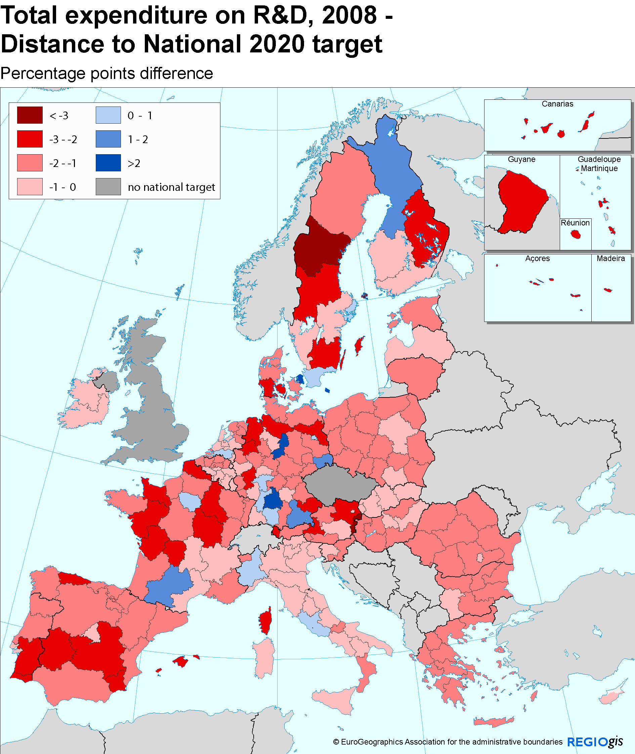
R&D

Slide 16
R&D
The EU 2020 headline target should obviously not be reached by all regions.
Too narrowly focused on science and technology, which need a certain scale or critical mass of activities not present everywhere.
Regional innovation strategies should involve a rigorous assessment of regions’ strengths and weaknesses and…
… cover all dimensions of innovation, involve key regional actors, and identify appropriate policy mix:
  R&D, support to SMEs;
  Organisational and process innovation;
  human capital;
  Infrastructure (e.g. incubators, ICT, transport).

Slide 17
Sustainable Growth
Enhancing resource efficiency
Foster low-carbon world
Preventing environmental degradation and
biodiversity loss
Promote green and competitive economy

Slide 18
Resource efficiency
Europe 2020 targets:
  Reduce greenhouse gas emissions by at least 20 % (and 30 %, if the conditions are right) compared to 1990;
  Increase energy efficiency by 20%;
  Increase consumption of renewable energy by 20 %.
The overall emission reduction goal will be accomplished through (i) the EU Emissions Trading System (ETS) and (ii) the ‘Effort Sharing Decision’.
‘Effort Sharing Decision’ sets the target of reducing greenhouse gas emission targets from sectors not included in the ETS – such as transport, buildings, agriculture and waste – by 10%.

Slide 19
Resource efficiency
Cohesion Policy actions can better support emission reduction within the ‘Effort Sharing Decision’ rather than the ETS.
Under the ‘Effort Sharing Decision’, MS have adopted a mix of emission reduction targets and limits on emission increases.
Some have already reached their target and only need to maintain this lower level of emissions (e.g. Greece or Slovakia).

Slide 20
Effort sharing decision

Slide 21
Resource efficiency
The share of renewable energy in gross final energy consumption varies from 44 % in Sweden to 0.2 % in Malta.
All Member States, except Latvia and Slovenia, have increased renewable energy consumption, with especially high increases in Austria, Estonia and Romania.
Some Member States are close to their target (Sweden: + 4.6 pp).
For others , the distance to the target is greater and additional efforts will be required. (e.g UK: +13 pp and Ireland: +12 pp).

Slide 22
Renewable Energy

Slide 23
Regional dimension
Sustainable growth has an important regional dimension:
  Regional characteristics directly determine the extent to which EU regions can produce renewable energy (e.g. solar vs wind energy).
  Regions and cities can promote cleaner modes of public transport, adapted to the local context (e.g. focusing on infrastructure in regions where it is still lacking while targeting demand management in other regions).
  Regions can play a prominent role in fostering energy efficiency, in particular where actions must adapt to the local climate or context (e.g. urban vs rural areas, old vs new buildings).
  Regional and local authorities are key actors for investments in green infrastructure (requires deep knowledge of local context).
Data not available at regional NUTS 2 or 1 level!

Slide 24
Urban eco-efficiency

Slide 25
Inclusive growth
Increase employment rates and the quality of jobs
Help people anticipate and manage change by investing in skills and training
Reduce poverty and exclusion

Slide 26
Employment
Europe 2020 tagetr: increase the employment rate to 75 % for the population aged 20-64 by 2020.
Member States have set national targets varying from 62.9 % in Malta to 80 % in Denmark and Sweden.
Not all Regions are expected to reach the EU or national employment targets, as they face very different starting positions.
If the goal was to reach the 2020 target in all convergence regions, 11 million people would have to find a job; 3 million in transition regions; 9.4 million in RCE regions.

Slide 27
Employment
Employment rates below 60 % can be found in southern Spain and southern Italy and some regions in Romania and Hungary.
Many regions in Germany, the UK, the Netherlands, Denmark, Sweden and Austria are above 75 %.

Slide 28
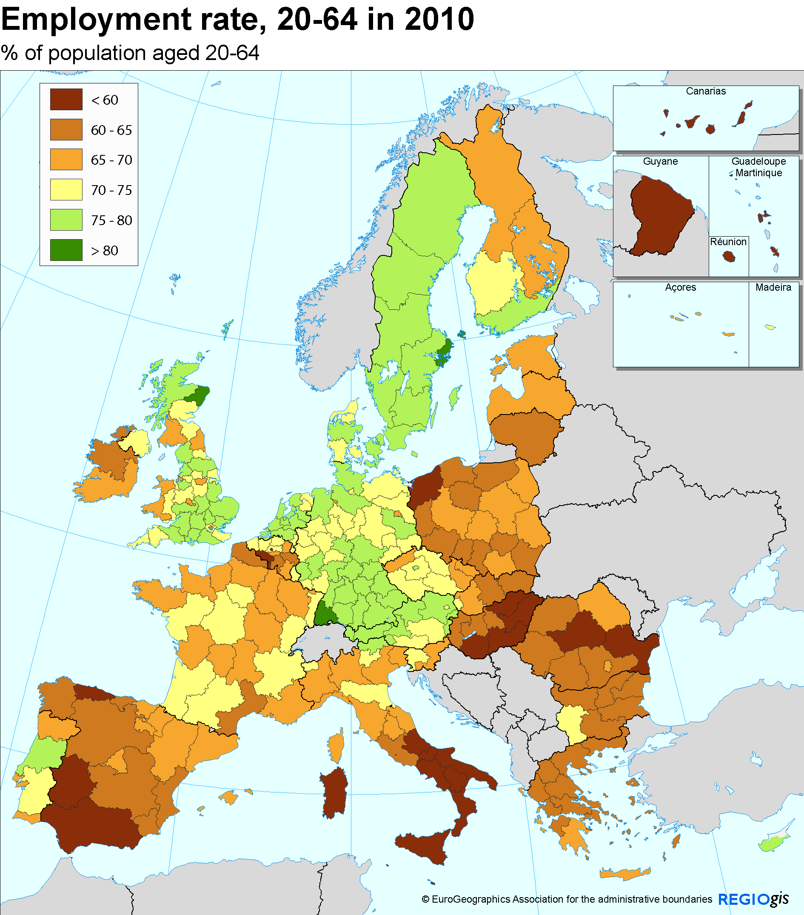
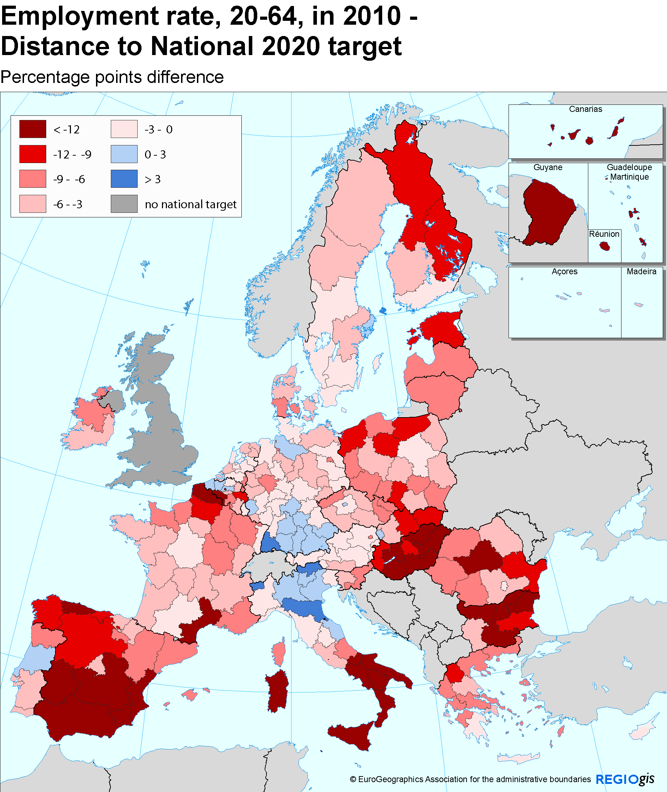
Employment: Northwest vs. the rest

Slide 29
Unemployment
Economic crisis led to rapid increases in unemployment rates.
In the three Baltic States and seven Spanish regions unemployment rates increased by between 10 and 18 pp.
Despite the overall increases, unemployment decreased in 52 regions, mostly in Germany but also in some regions in Poland, France, Finland and Austria.

Slide 30
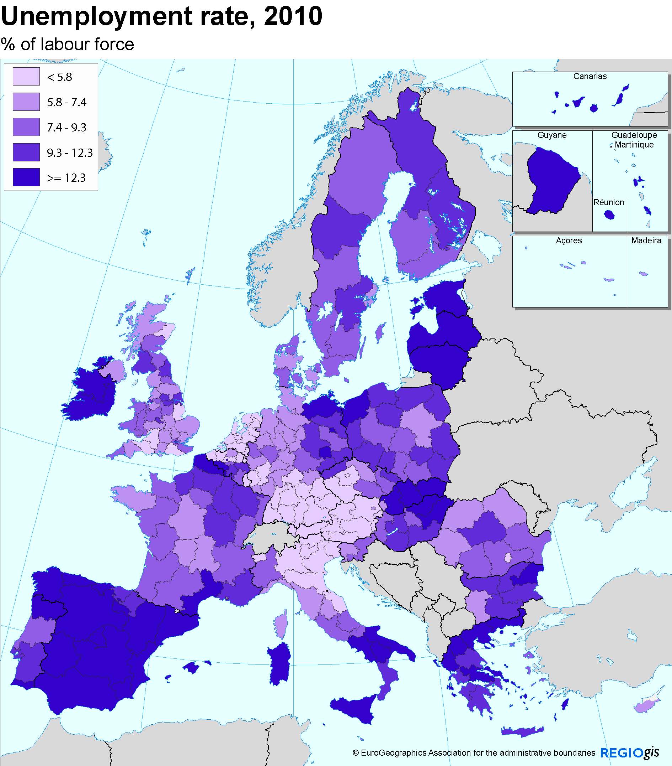
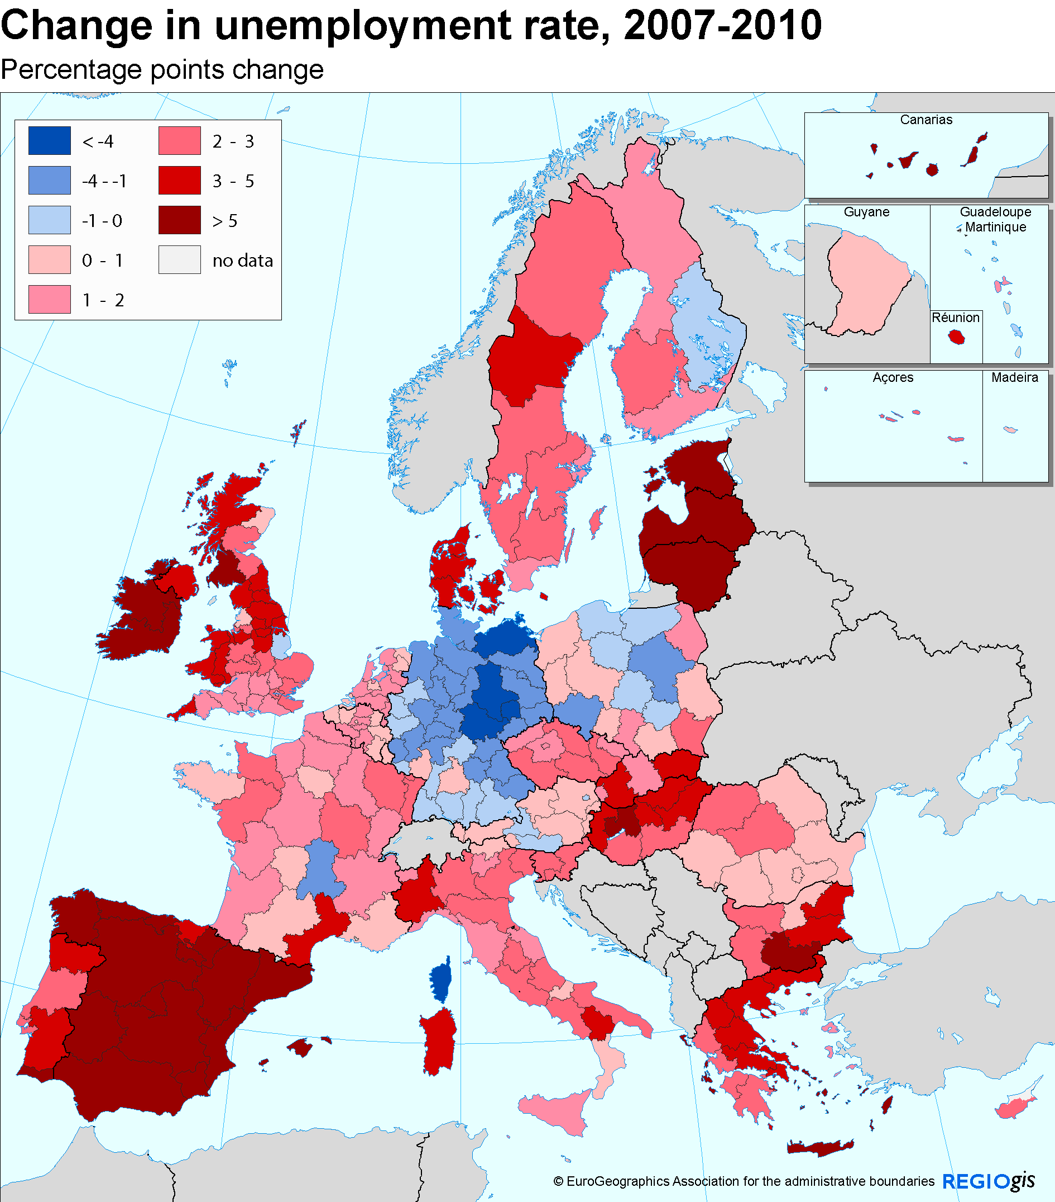
Unemployment: impact of the crisis

Slide 31
Poverty and social exclusion
Europe 2020 target: reduce the number of people at risk of poverty or exclusion by 20 million by 2020 (i.e. from 23 % of the EU population to 19 %).
The share of population at risk of poverty or exclusion is over 50 % in three Bulgarian regions and is 49 % in Sicily.
The lowest rates can be found in Åland, Trento, Navarra and Praha, where is it 10 % or lower.

Slide 32
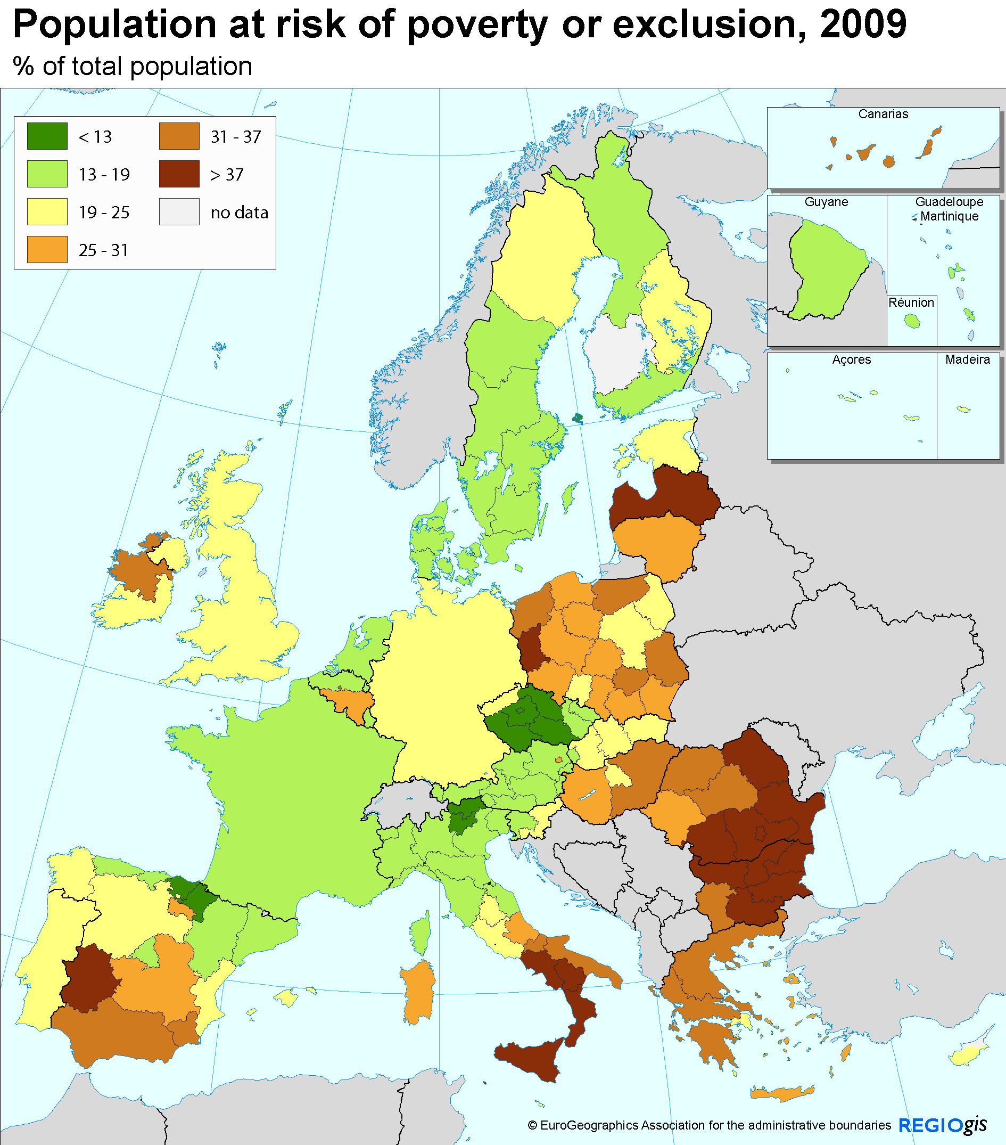
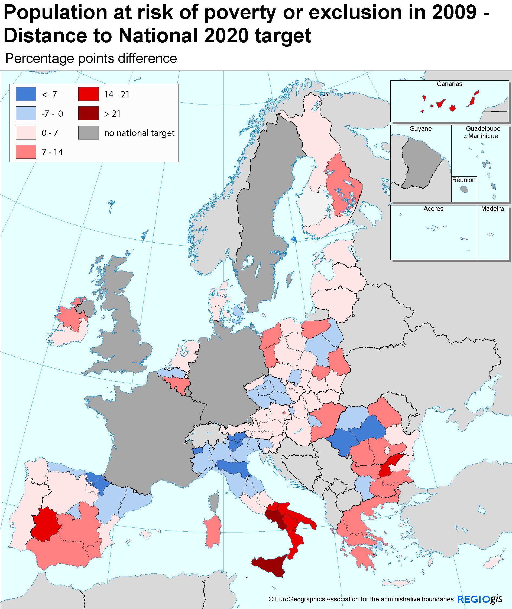
At risk of poverty and exclusion: South/East divide

Slide 33
Poverty and social exclusion
The at-risk-of-poverty rate has a strong regional dimension.
Besides personal characteristics (education, employment status, household type and age), the at-risk-of-poverty rate also depends on where people live (‘location effect’).
Example - the urban paradox: urban poverty is inversely related to the level of economic development: the more developed Member States tend to have less inclusive cities.
At-risk-of-poverty-or-exclusion data not available at regional NUTS 2 or 1 level in several large Member States.

Slide 34
East West divide on urban poverty

Slide 35
Conclusion
Europe 2020 is an ambitious strategy.
Requires a different policy mix in countries (National Reform Programmes).
Also requires a different policy mix in regions (Partnership Contract). This implies flexibility.
If actions are appropriately tailored to the local context, regions can developed and at the same time contribute to achieve Europe 2020 objectives.
Challenging but it is the fundamental idea behind place-based integrated policy!

Slide 36
Thank you for your attention

